Slide 1
Revision Record
Don’t Print This Page
COURSE CODE
PRODUCT
PRODUCT VERSION
COURSE VERSION
Domain
Huawei IPCC and Platform Introduction
NA
eSpace CC ISV V100R001C01LINH04
DEVELOPER / MODIFIER
DATE
APPROVER
NEW / UPDATE
VIJAYASARATHY P. R.
2011-10-12
NEW

Slide 2
Contact Center Orientation

Slide 3

Objectives
Upon completion of this course, you will be able to understand:
The purpose of a Contact Center
Core technology behind modern Contact Center
Services offered by different Contact Center
The Evolution in Contact Center technology

Slide 4

Target Audience
This course has been designed to have knowledge of Contact Center Concepts. The intended audience is:
Consultants
System Administrators
Telecom Professionals

Slide 5
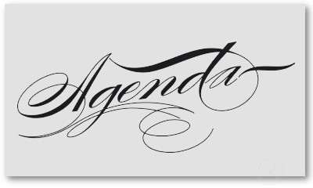
OVERVIEW
HUMAN RESOURCES IN CONTACT CENTER
CORE COMPONENTS
TYPES OF CONTACT CENTERS
BASICS OF OUTBOUND
BASICS OF MULTIMEDIA
IMPLEMENTATION SCENARIOS

Slide 6




Contact Center - Overview
The Contact Center facility is the first point of contact for customers to reach out to enterprises for any of their enquiries, complaints or requests. The contact center would help enterprises improve their customer experiences thus enhancing their revenue.
Purpose of a Contact Center
Contact Center Services
Evolution of Contact Centers
Trend in Contact Centers
Call Center to Contact Center

Slide 7



Contact Center - Purpose
Contact Center is comprehensive voice operations Center that provides a full range of high-volume, inbound or outbound call-handling services, including customer support, operator services, directory assistance, multilingual customer support, credit services, card services, inbound and outbound telemarketing, interactive voice response and web-based services.
Organization
Contact Center
Customer

Slide 8
Contact Center Services
Following are some of the services provided by contact Centers:
Inbound Services
Outbound Services
Customer Support
Order Entry
Reservations
Registrations
Information Enquiry
Technical Support
Telemarketing
Reminders
Customer Survey
Market Research
Product Promotions
Notifications
Notes:
Order Entry : Say a customer calls the a Contact Center, running for a fast food chain, for placing an order for a home delivery.

Slide 9
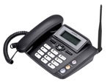
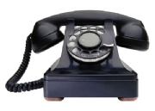
Evolution of Contact Center
The advancements in the field of IP has led to a shift in Contact Center Technology. From a traditional Time division Multiplex (TDM) based infrastructure, the focus has shifted to modern IPCC which provides better benefits to businesses in terms of cost, scalability, mobility, etc.

Slide 10
Trends in Contact Centers
The technology and expectations from a contact center has changed a lot, below are the highlights of the present contact center trends:
PEOPLE
Outsourcing
Off-Shore Centers
Intelligent Routing
Customer Value Based Service
Integrated View of Customer throughout lifecycle
PROCESS
Multimedia Services
Customer Self Service Options
TECHNOLOGY
Customer – 360 degree view
Seamless Integration is Goal
Collaboration & “One Customer” Views
Notes:
This slide speaks about the latest trends in a contact center.
Best practices to improve customer satisfaction
New services require investment in technology
Expansion of services without increased headcount
Stable or shrinking support budgets
Demand for flexible staffing for peaks, seasonality and product launches

Slide 11
Call Centers Contact Centers
Customer Requirements Expand
Multimedia Face to Face, Phone, Email, Web, Chat
Intelligent: Knowledgebase, Search Engines, Intelligent Autobots
Individualized: Customer 360 degree view, History
Any Time, Anywhere: 24/7 Access
Global: Follow the Sun Customer Service
Notes:
This slide speaks about how the typical call center has changed to become a contact center.
As the customer needs have increased more and more innovative ways to connect to the contact center are coming up. As a result of all this the call centers have become a contact center. An Information Hub rather than plain old complaint/service center.

Slide 12
OVERVIEW
HUMAN RESOURCES IN CONTACT CENTER
CORE COMPONENTS
TYPES OF CONTACT CENTERS
BASICS OF OUTBOUND
BASICS OF MULTIMEDIA
IMPLEMENTATION SCENARIOS

Slide 13


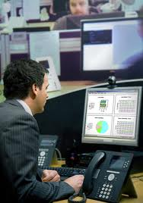


Human Resources in Contact Center
Agents: Serve Customers who reach the contact Center
Supervisors: Manage a Group of Agents
Quality Inspectors: Manage Quality
Manager: Manage overall Contact Center
IT Team: Manage the Contact Center technology Infrastructure
Notes:
Agents: They form the core human resource in a contact Center. Agents provide the required services to the customers who reach the contact Center for assistance.
Supervisor: They manage a group of agents, monitoring the performance of the agents, and are responsible to meet the Service Levels of the contact Center
Quality Inspectors: They are responsible for the quality of service provided by the agents and ensure the customer service is consistent and of desired quality.
Manager: He/She is responsible for the performance of the contact Center in terms of Key performance indicators, Service Levels etc…
IT team: They are responsible for implementing, maintaining the contact center technology infrastructure implemented in the organization.

Slide 14
OVERVIEW
HUMAN RESOURCES IN CONTACT CENTER
CORE COMPONENTS
TYPES OF CONTACT CENTERS
BASICS OF OUTBOUND
BASICS OF MULTIMEDIA
IMPLEMENTATION SCENARIOS

Slide 15
Core Components
Following are a few common components in a contact Center scenario:
ACD: Automatic Call Distributor – Contact Distribution
CTI: Computer Telephony Integration – Screen pop, Telephony control, Intelligent Routing
IVR: Interactive Voice Response – Self Service functionality
Logger – Recording of Conversations
Reporting – Information on Historical Data
Note:
There are other components which may be part of the Contact Center Infrastructure depending upon the services provided and the size of the contact Center.
Notes:
ACD: Assigns contacts to the right agent the first time. Can be embedded along with the PBX or be a separate component outside the PBX it also helps in:
Routing of Contacts (Voice, Email, Web etc) to the Right Skilled Agent who can handle the customer optimally.
Intelligent Routing to the most Idle agent
Routing based on the CLI or preferred agent
Queuing of Calls based on priority.
Helps Supervisor to provide information required to manage the contact center
CTI: Responsible for screen pop of customer information on agents desktop upon call arrival. It provides the telephony controls to the agents to answer, hang-up, transfer, forward a call etc. .Monitors the availability of the agents and informs the ACD on agent status (idle, busy, break etc..). Also used for intelligent routing of calls based on time, location etc…
IVR: Responsible for providing self service to callers for routine enquiries that may not need the assistance of a human agent.
Logger: Responsible for recording the contacts between agents and callers for audit and regulatory purposes.
Reporting: Responsible to provide accurate data regarding the performance of the contact Center in terms of calls, agents, SLA etc…

Slide 16
Technology enablers
CRM Integration. Flexible integration with leading vendors’ CRM applications
CTI Support. Ability to support client preferences across major CTI platforms
Outbound Notification. Support of voice, text, SMS messaging
System scalability. Larger and wider customer base to be supported
Survivability & Security. Comprehensive business continuity planning and redundancy

Slide 17
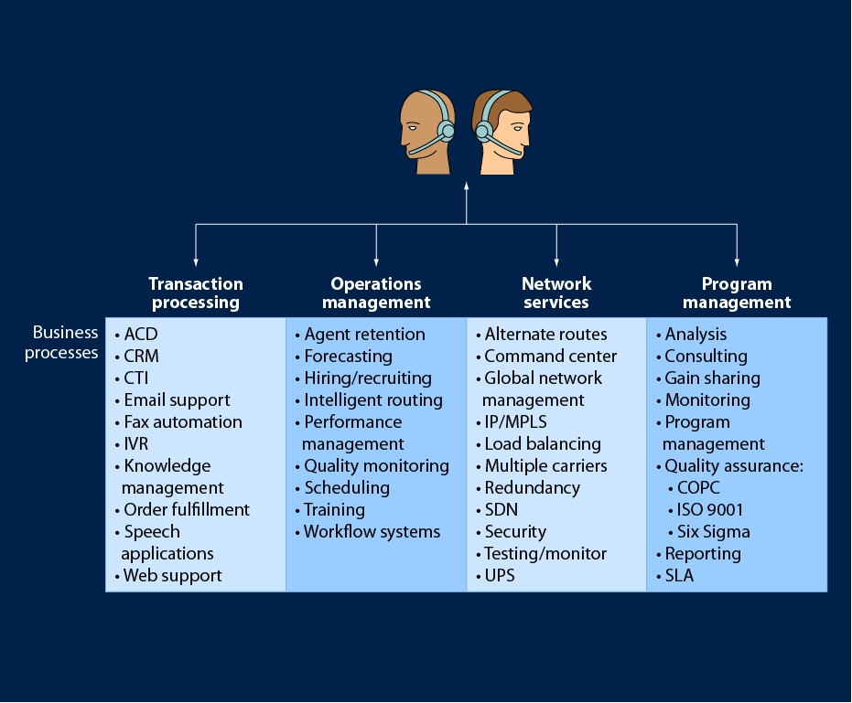
Processes of Contact Centers
Notes:
Types of transactions supported: Range of transactions supported including BPO
Reporting and metrics: Supports clients with real-time access to metrics across a comprehensive set of reports
Process improvements: Internal process guidelines and adherence to industry quality processes
Quality monitoring and workforce management: Use of commercial applications with internal team dedicated to quality performance
Agent and supervisor training: Continuous training and advancement opportunities

Slide 18
Process enablers
Range of transaction to be supported
Reporting and metrics: Supports clients with real-time access to metrics across a comprehensive set of reports
Process improvements: Internal process guidelines and adherence to industry quality processes
Quality monitoring and workforce management: Use of commercial applications with internal team dedicated to quality performance
Agent and supervisor training: Continuous training and advancement opportunities
Notes:
Ensure that all contact Centers have core competency
Consistent measure of performance for all Centers
Same ruler for success – both internal and external Centers

Slide 19
OVERVIEW
HUMAN RESOURCES IN CONTACT CENTER
CORE COMPONENTS
TYPES OF CONTACT CENTERS
BASICS OF OUTBOUND
BASICS OF MULTIMEDIA
IMPLEMENTATION SCENARIOS

Slide 20
Types of Contact Center
Contact Centers are classified into three types: Inbound, Outbound and Blended
These Contact Centers serve the customers who initiate the call to the Contact Center to fetch some information regarding the services or products.
They may handle incoming contacts like voice, email, SMS, fax, Web Chat, MMS etc.
These Contact Center initiates the call to customers / prospective customers.
These may be for the purpose of informing customers of new products or telemarketing etc.
These contact Centers offer both inbound and outbound services.
Agents in this type of Contact Center can serve both the customer as well as prospective customer.
Inbound Contact Center
Outbound Contact Center
Blended Contact Center:
Notes:
Inbound Contact Center is a place where the Customer initiates the communication to the contact center to get some information on the products or services provided by the contact center.
Outbound Contact center, the contact center initiates the communication with the customer or the business prospects. The contact center provides the info about the services and products provided by the organisation.
Blended contact center has both the inbound as well as an outbound contact center setup in its premises.

Slide 21
Types of Contact Center…
Organization
Contact Center
Customer
CAPTIVE
Setup to service in-house organization needs
Organization
3rd Party
Contact Center
Customer
OUTSOURCED
Setup to service in-house and 3rd party needs
Notes:
Captive Contact Center : Captive centers are those centers that are operated for servicing their own clients and not third party clients.
Outsourced Contact Center: Contact Center setup to fulfill third party organization needs in addition to it’s own.

Slide 22
Types of Contact Center…
The contact center provides the services to only to the Domestic Customers
Domestic Vs International
Contact Center
Customer
DOMESTIC (Onshore)
The contact center provides the services to only to the International Customers
Contact Center
Customer
INTERNATIONAL(Offshore)

Slide 23

Types of Contact Center
Hosted Vs Premise Based
Organization
Hosted Call Contact Provider
HCCP
PREMISE BASED
Setup within organization premises
HOSTED
Setup within 3rd party premises by HCCP
Notes:
Premise Based Contact Center : The Contact Center is present in the same premises.
Hosted Contact Center : The Contact Center process is running in the setup which is in the third party premises

Slide 24
OVERVIEW
HUMAN RESOURCES IN CONTACT CENTER
CORE COMPONENTS
TYPES OF CONTACT CENTERS
BASICS OF OUTBOUND
BASICS OF MULTIMEDIA
IMPLEMENTATION SCENARIOS

Slide 25
Why Outbound Contact Center Is Needed?
Contact centers can bring revenue to the organization by contacting customers / potential customers
The enterprises need to directly contact customers and obtain the latest customer
Sales channels with low costs
Wide sales area
Low sales gross margin
Limited channels for collecting customer information
Demand on developing, maintaining, and consolidating customer relationships
Notes:
provide activities like reminders about payment due dates, pending payment information, create opportunities to sell
By directly contacting the customer and gathering information helps to prevent agents or middlemen from attracting customers by themselves

Slide 26
Challenges Faced by Enterprises
Customer Loss.
Marketing Cost
Customer Relationship management
New services/Product Info sharing
Large OPEX and CAPEX
Notes:
Customer Loss : In the competitive and saturated product market, customers have more choices. As a result, the enterprises must differentiate customer groups and provide customized services for them to maximize customer values and enterprise interests
Marketing Cost : The enterprises need to improve the marketing achievements while reducing the cost for attracting new customers and maintaining the customer relationship.

Slide 27

Challenges to Traditional Marketing Mode
Fierce External Competition
Short period for a product launched to the market
Low Marketing Efficiency and High Sales Cost
Low success rate of outbound calls
Aimless marketing, resulting in the low success rate of marketing
High labor costs
Inadequate marketing channels and high marketing costs
Customer’s Complaints for Marketing
Promotion of undesired products to customers
Aimless marketing, resulting in customer resentment
Uncontrollable Marketing Process
Difficulty in appraising
Nontransparent marketing process, causing the result that the implementation result of the marketing policy cannot be predicted
Distributed data, causing the result that the marketing result cannot be referred by subsequent marketing
Notes:
挑战

Slide 28



Overcoming traditional marketing challenges by Proactive Outbound Call Service
Collect feedback information from customers and evaluate the feedback results
Define the marketing theme
Select target customers
Planning of Enterprise Outbound Call Marketing
Outbound Call Platform
Define the marketing contents
Provide customized service contents
Define the marketing policy
Contact the target customers
Service emphasis: Though an enterprise cannot rely on the proactive outbound call service to complete the whole sales process of all products, the proactive outbound call service is necessary for the sales. In addition to the proactive outbound call service, the complete sales process contains customer care and customer feedback.

Slide 29
Application of Outbound Call Service
Automatic/Predictive outbound call of agents
The calling list is large or the quality of the contacts in the calling list is poor.
Agent less campaigns for reminders/promotions
The unit price of product is too low hence the calls can be initiated automatically
Manual/Preview outbound calls of agents
The quality of the list is high.
The calls are made to VIP customers, customer may not want
Unit price of products is high, hence the person to whom we need to sell needs to be selective and convinced
Agent needs to possess better skill in the product and communication

Slide 30
Improve Agent Usage by Accurate State Detection
The system automatically detects the states of outgoing calls and records the results, and then processes the calls according to the outgoing call policies. This avoids the problem that invalid outgoing calls are allocated to agents, which improves the efficiency of initiating outgoing calls.
The system can recognize the following types of tones:
Busy tone
Ring back tone
Fax and Modem tone
RBT tone
Person's voice
Tone of an automatic answer device
Start
Signaling
Detection
Tone
Detection
The accuracy of outbound call detection is higher than 97%.
Check Flow
End

Slide 31

How to Make Outbound Calls Efficient?
Factors to be considered:
Capacity and quality of the name list
Predicted outbound calling workload
Value of the products to be sold
Progress of the outbound call project
Outbound call detection capability of the platform

Slide 32
OVERVIEW
HUMAN RESOURCES IN CONTACT CENTER
CORE COMPONENTS
TYPES OF CONTACT CENTERS
BASICS OF OUTBOUND
BASICS OF MULTIMEDIA
IMPLEMENTATION SCENARIOS

Slide 33
Why Multimedia Contact Center Is Needed?
Traditional telephone support dominates today but customer behavior is changing
Customers now desire multiple contact methods/channels(e.g. Phone, Chat, Email, Fax, SMS etc)
Integrated support required for online and speech-enabled IVR interactions
Lower cost channels offer financially attractive option to companies with large contact Centers

Slide 34
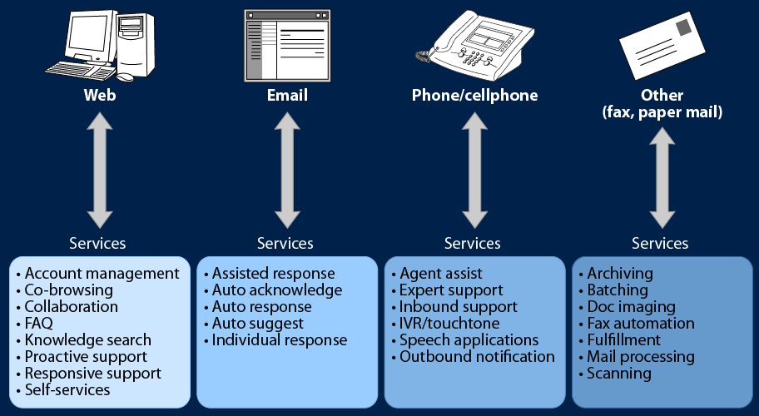
Multimedia Channel Touch Points and Key Usages

Slide 35
Multimedia Offerings
CSR collaboration: Online support for Chat, Co-browse, Web Callback, Click to Dial, SMS, MMS, shared screens etc.
Email support: Supports multiple types of email interactions with full integration to agent desktop
IVR support/speech recognition: Advanced capabilities to support speech-solutions in addition to DTMF
Offline support: Support for paper, forms, fax, fulfillment
CSR desktop integration: Agents view an fully integrated 360 degree view of customers
Video IVR and Video Calling

Slide 36
Strategic drivers for Multimedia
Improve Customer Satisfaction, Loyalty, Revenue
Increase strength/reputation of brand
Increase repeat business and cross-sales
Increase Quality of Service (wait times, abandon rate)
Improve Employee Morale
Reduce returns due to poor customer service
Reduce cost of sales via customer referrals
Reduce Customer Care overhead
Reduce Training Costs
Reduce Turnover, hiring/on-boarding Costs

Slide 37
OVERVIEW
HUMAN RESOURCES IN CONTACT CENTER
CORE COMPONENTS
TYPES OF CONTACT CENTERS
BASICS OF OUTBOUND
BASICS OF MULTIMEDIA
IMPLEMENTATION SCENARIOS

Slide 38
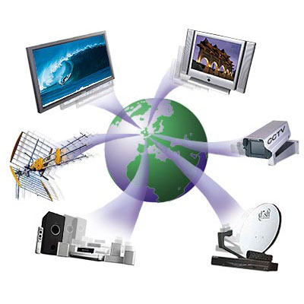
Implementation Scenarios
Inbound
Outbound
Multimedia

Slide 39
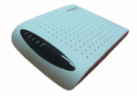



Implementation Scenario - Inbound
Requirement: A Telecom company is upgrading it’s Call Center Technology. The Call Center has about 150 agents and had significantly invested on the Analog handsets in their previous implementation. The new Call Center Technology is totally IP Based. How can the Call Center leverage the existing Analog handsets?
Solution: The Call Center can achieve POTS integration through an IAD(Integrated Access Device) which would enable IP to TDM conversion.
Requirement: A Directory Services Company wants to introduce a Directory Enquiry facility via phone calls. The Company is facing resource crunch and unable to recruit the agents for the same. Considering this, what would be an optimal automation strategy?
Solution: The Company can setup an IVR with ASR and TTS facilities. Depending on the customer voice command, the IVR can interpret and lookup for the required directory information.
IAD101/102
IAD104H
IAD132(E)T
IAD304B
IAD316B

Slide 40
Implementation Scenario - Inbound…
Requirement: A Bank has launched a new Call Center. However, the agents are getting swamped with repetitive queries on account balance, loan scheme enquiries, utility bill payments etc. The service level has significantly dropped and the agent morale has been hampered. What should the Bank do to overcome this?
Solution: The Bank can handle the repetitive queries by giving self service options to the caller via IVR. The IVR can interact with the backend host and provide account related information and utility bill payment services. The IVR can also play static messages to give introductory information on various loan schemes. The caller will still have an option to get an agent assistance at any point in the IVR to get a response on any specific query. This will significantly reduce the agent occupancy and improve the overall service level.

Slide 41
Implementation Scenario - Inbound…
Requirement: An Airlines setting up a Contact Center wishes to differentiate itself by offering enhanced customer experience. One of the proposed measures is to address the customer by his first name and also offer value added services based on the customer profile and IVR interaction history. What should be done to achieve this?
Solution: The Contact Center can be CTI Screen pop enabled to provide the agent the customer name, customer profile/preferences and IVR interaction history. Empowered with this information, the agent should be able to offer personalized service and improve the overall customer experience.

Slide 42
Implementation Scenarios
Inbound
Outbound
Multimedia

Slide 43
Implementation Scenarios - Outbound
Requirement: A Bank has about 2,000,000 Credit Card customers. About 15% of the customers are normally delinquent up to 1 month. These customers are normally self curing after 1-2 reminder calls. The Bank is down sizing the number of agents due to financial crisis. What is the optimal strategy for handling delinquency below 1 month?
Solution: The Bank can setup a blaster campaign using an outbound predictive dialer. This would lead to agent less campaign for addressing the delinquency below 1 month.
Requirement: A Real Estate Company is planning to reach out to a select list of prospective customers. The agent would have study the profile, preferences and past interaction history of the customer prior to dialing out to the customer. What would be an optimal out dialing strategy over here?
Solution: Preview or Timed Preview Out dialing campaign would be an ideal strategy over here.

Slide 44
Implementation Scenario - Outbound…
Requirement: A Telemarketing company reaches out to the prospective customers for selling it’s high value real estate products. This requires a dedicated relationship between the telemarketing agent and the prospective customer until the sale is closed. It’s also important for the customer to reach vast number of prospective customers in order to achieve the desired targets. What is the best strategy for achieving this?
Solution: The Telemarketing company can setup a predictive dialing solution for improving their coverage. They can setup a Same Agent Call Back(SACB) campaign to achieve the dedicated relationship.

Slide 45
Implementation Scenarios
Inbound
Outbound
Multimedia

Slide 46
Implementation Scenarios - Multimedia
Requirement: A Government Department has newly setup a Survey Portal to gather information about the sanitary conditions in the Metro Cities. The intent is reach to a wide audience and gather unbiased and accurate opinion through the Survey Forms in the Portal. However, lot of people from low income/low computer literacy group are having difficulties in accessing the Portal and properly filling the Survey Forms. What is the best strategy to address this?
Solution: The Government Department can setup a Multi-Media Contact Center with Web Chat Channel with Co-Browsing and Form-sharing facilities.
Requirement: A Laptop Manufacturing Company has a delayed SLA/Response time of 24 hours for any fault/complaint based on the warranty terms. What would be an ideal channel suited for it’s Help Desk Contact Center?
Solution: The Email channel would be an ideal channel for this type of interaction.

Slide 47
Glossary
SMS. Short Message Service
TDM. Time Division Multiplexing
CTI. Computer Telephony Interface
ACD. Automatic Call Distributor
IVR. Interactive Voice Response
MMS. Multimedia Messaging Server
CRM. Customer Relationship Management
MPLS. Multi Protocol Label Switching
SDN. S4C Digital Networks
DTMF. Dual Tone Multi Frequency
SLA. Service Level Agreement

Slide 48
Thank You
www.huawei.com

